Slide 1
Designing the desired application
Mostafa Rastgar
june 2019

Slide 2
Agenda
Review the desired application
Decomposition Patterns
Proposing a suitable architecture
Designing application’s microservices

Slide 3
Review the desired application
Payment Project
Receive Payment Order
Validation
Final Process
Syntax
Receive a new Payment Order
Send to beneficiary
Semantic
Withdraw the available balance
Insert ledger
Receive a Negative Status
Validation
Final Process
Syntax
Receive a negative status
Cancel the original payment
Semantic
Deposit the available balance
Send the final status to the both beneficiary and originator

Slide 4
Decomposition Patterns
Decompose by Business Capability
Microservices is all about making services loosely coupled, applying the single responsibility principle. However, breaking an application into smaller pieces has to be done logically. How do we decompose an application into small services?
One strategy is to decompose by business capability. A business capability is something that a business does in order to generate value. The set of capabilities for a given business depend on the type of business. For example, the capabilities of an insurance company typically include sales, marketing, underwriting, claims processing, billing, compliance, etc. Each business capability can be thought of as a service, except it’s business-oriented rather than technical.

Slide 5
Decomposition Patterns
Decompose by Subdomain
Decomposing an application using business capabilities might be a good start, but you will come across so-called "God Classes“ which will not be easy to decompose. These classes will be common among multiple services. For example, the Order class will be used in Order Management, Order Taking, Order Delivery, etc. How do we decompose them?
For the "God Classes" issue, DDD (Domain-Driven Design) comes to the rescue. It uses subdomains and bounded context concepts to solve this problem. DDD breaks the whole domain model created for the enterprise into subdomains. Each subdomain will have a model, and the scope of that model will be called the bounded context. Each microservice will be developed around the bounded context.
Note: Identifying subdomains is not an easy task. It requires an understanding of the business. Like business capabilities, subdomains are identified by analyzing the business and its organizational structure and identifying the different areas of expertise.

Slide 6
Decomposition Patterns
Strangler Pattern
So far, the design patterns we talked about were decomposing applications for greenfield, but 80% of the work we do is with brownfield applications, which are big, monolithic applications. Applying all the above design patterns to them will be difficult because breaking them into smaller pieces at the same time it's being used live is a big task.
The Strangler pattern comes to the rescue. The Strangler pattern is based on an analogy to a vine that strangles a tree that it’s wrapped around.

Slide 7
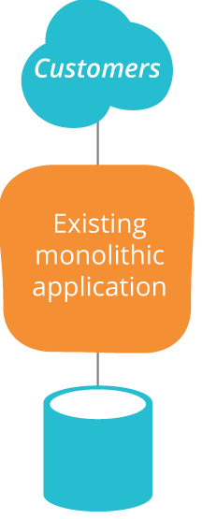
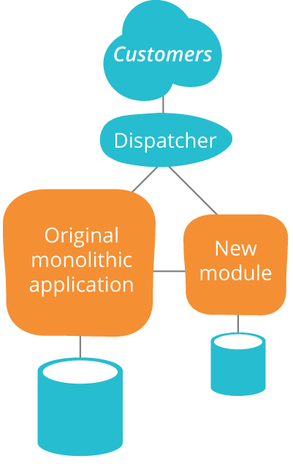
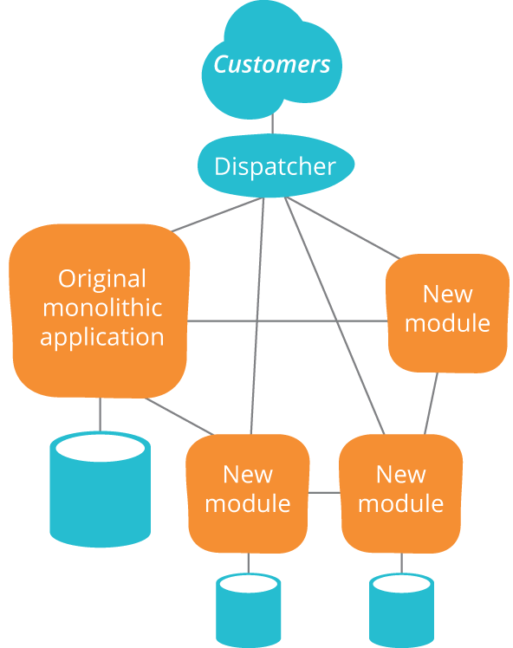
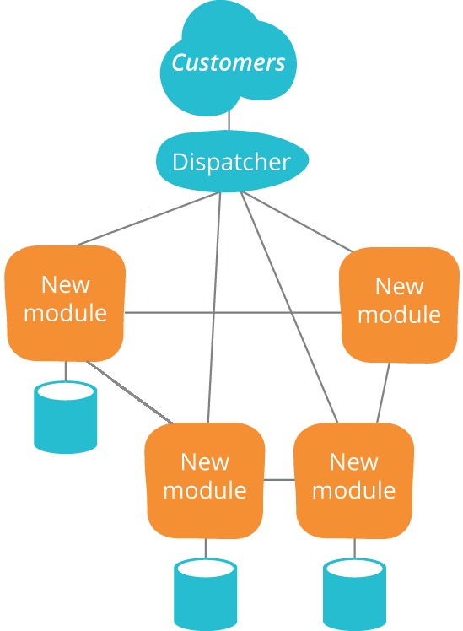
Decomposition Patterns
Strangler Pattern schematic diagram

Slide 8
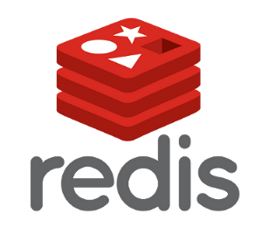







Proposing a suitable architecture
$$S_{2}$$
$$S_{1}$$
$$S_{3}$$
$$S_{n}$$

Slide 9
Designing application’s microservices
Validation
Syntax
Semantic
Receive Payment Order
Validation
Message Validator
Receive a new Payment Order
Withdraw the available balance
Deposit the available balance
Balance Manager
Message Processor
Final Process
Receive a Negative Status
Final Process
Response Sender
Receive a negative status
Send to beneficiary
Send the final status to the both beneficiary and originator
Insert ledger
Cancel the original payment

Slide 10
Designing application’s microservices
Kafka topics:
balance-check
32 partitions
Balance-check-result
32 partitions
bank1-out
SLA-based number of partitions
…
bankn-out
SLA-based number of partitions

Slide 11


